Slide 1
Project Tacker
Open Platform for NFV Orchestration
V1.1 / 02/16/16

Slide 2
Agenda
Overview
Evolution
Architecture
Features
Roadmap
Community

Slide 3
Tacker Overview

Slide 4
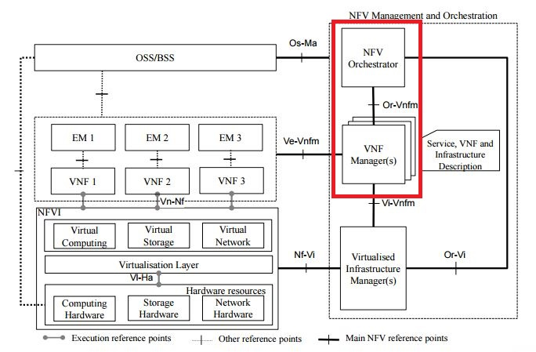
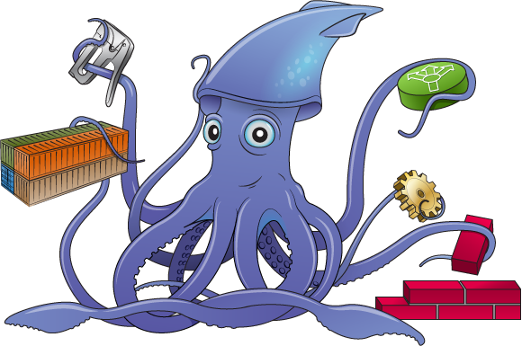
What is Tacker?
Tacker
is an official OpenStack project for
NFV Orchestration and VNF Management using standards based architectures

Slide 5
Tacker Project Overview
Official OpenStack Project (big-tent)
Core Team – PTL + 3 Core Members
Lines of Code – 70K LOC
CI: Unit and Functional tests
Vibrant community of developers, reviewers and architects
* as of JAN 2016
Notes:
[1] https://www.openstack.org/summit/vancouver-2015/summit-videos/presentation/tacker-virtual-network-function-life-cycle-management-for-openstack

Slide 6
Tacker Project Overview
Pivoted to NFV Orchestration early 2015
Announced in OpenStack Vancouver Summit – May, 2015
Packed sessions in OpenStack Tokyo Summit –
BoF, vBrownBag, Marketplace demo (vEPC, vRouter)
Wrapping up its third release
* as of JAN 2016
Notes:
[1] https://www.openstack.org/summit/vancouver-2015/summit-videos/presentation/tacker-virtual-network-function-life-cycle-management-for-openstack

Slide 7


Tacker Project Timeline
Mar 2015
Pivot to NFV Orchestration
Mar 2016
Official OpenStack project !!
Nov 2014
Orchestration flagged as a gap in Telco WG in Paris Summit
Nov 2015
Pluggable monitoring driver demo in OpenStack Paris Summit
SFC demo in OPNFV Summit
Liberty release
May 2014
Tacker started as Neutron ServiceVM project
May 2015
Demonstrated VNFM in OpenStack Vancouver Summit
Kilo release
Apr 2016
Multi-Site
TOSCA Parser integration
EPA
Mitaka release
2014
2015
2016
2017

Slide 8
Tacker Community

Slide 9
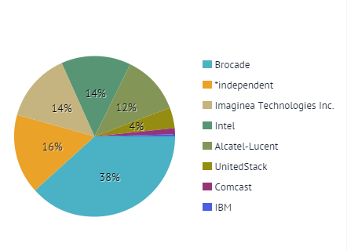
Tacker Stackalytics - Liberty
Notes:
URL: http://stackalytics.com/?release=liberty&project_type=openstack-others&module=tacker&metric=patches

Slide 10
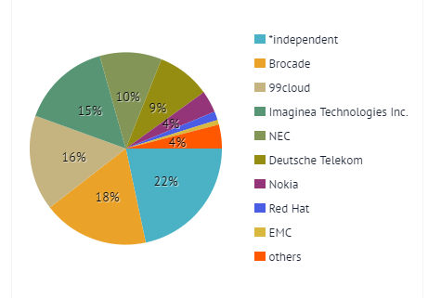
Tacker Stackalytics - Mitaka
Notes:
http://stackalytics.com/?module=tacker-group&metric=patches

Slide 11
Tacker Architecture

Slide 12
Tacker Architecture
API
(WSGI, extension /plugin framework)
NFV
Catalog
NFVO
OpenStack
Driver
VMware
Driver
Custom
Driver
Multi-Site
TOSCA
Workflow
VNF
Fwd Graph
VIM Sites
Network
Service
Instances
Service
Chains (SFC)
VNFM
Config
Driver
TOSCA
Workflow
Monitoring
Framework
TOSCA Template
Validation
VNF Instances

Slide 13


Tacker Workflow
NFVO / OSS / BSS
VNFD catalog
GUI
CLI
API
VIM
1
5600-vRouter
2
Tacker
vEPC VNF
HEAT
infra
driver
NFVO / VNFM / VNFFG API
DPI VNF
monitoring
driver
MGMT driver
SFC
driver
FW VNF
openstack
Nova, neutron
5
Spin up/down
VMs
7
4
3
monitoring
Neutron-SFC
6
NetVirtSFC
Management Network
Tenant Y
vEPC
vRouter
VNF
VNF
FWaaS
VNF
DPI
Tenant Z
NFVI
(compute/network/storage)
Tenant Network
Notes:
On-boarding VNF’s – Writing template and using Tacker API for on-boarding VNF catalog
Uses Heat to instantiate VNF’s on VIM
Once instantiated next is configuration of VNF - Mgmt Driver fwk is used to configure VNF
Once VNF is functional, it may have to be chained. Option is to use ODL/BSC to control and render the chain
VNF is operational
Monitoring driver kicks in.
Failure event of VNF, handled by Tacker by re-spawning and auto-scaling

Slide 14
Multi-Site
Liberty
Mitaka
Tacker
Tacker
VIM 0
(local OpenStack Controller)
Site 1 - VIM
(default – local OpenStack Controller)
Site 2 -VIM
(OpenStack Controller)
Site 3 - VIM
(OpenStack Controller)
Tacker can instantiate VNFs only on same OpenStack controller
VNF placement on specific target OpenStack VIM
Explicit Region support

Slide 15
Multi-Site – multiple OpenStack versions
Tacker
Site 1
(OpenStack Kilo)
Site 2
(OpenStack Liberty)
Site 3
(OpenStack Mitaka)
Operators have multiple OpenStack VIMs with different OpenStack versions
Detect KeyStone and HOT template version and translate accordingly
Gracefully degrade features on older VIMs

Slide 16



Multi-VIM Type Support
Tacker
Site 1
OpenStack
Site 2
VMware ESXi
Site 3
AWS
Site 4
Custom
Orchestrate VNFs on different type of VIM’s
Introduce Tacker InfraDriver’s for VMware ESXi (TOSCA -> OVF)

Slide 17
Tacker Features

Slide 18
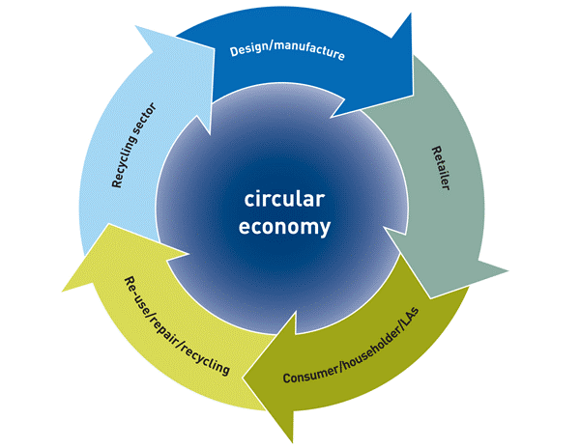
VNF Manager
VNF Catalog – repository of VNF descriptors (VNFDs) in a database
VNF Instantiation and Termination
VNF Monitoring - Health and Performance Indicators
Self Healing and Auto Scaling
VNF Configuration injection during instantiation
VNF Image management **
Support both simple and complex VNFs
Enforce placement policy
ensure efficient placement of VNFs (NUMA, CPU Pinning)
** in a future phase

Slide 19

NFV Orchestrator – Work in Progress
Templatized end-to-end Network Service using decomposed VNFs
Network Service Orchestration using a collection of VNFs and Forwarding Graphs
Ability to orchestrate VNFs across Multiple VIMs - available in Mitaka
VNFs connected using Forwarding Graphs using SDN Controller or a SFC API - planned for Newton
Resource Checks and Resource Allocation
PNF in end-to-end network service orchestration

Slide 20
Features
VNF Catalog
VNF Lifecycle Management
VNF user-data injection
VNF configuration injection – during Instantiation and Update
SDN Controller using NetConf/YANG
Custom management driver
Loadable Health Monitoring Framework
Automatic Resource Creation (flavor, image, network)

Slide 21
Tacker VNF Catalog
Repository of VNF Descriptors (VNFD)
VNF definition using TOSCA templates
Describes the VNF attributes
Glance image IDs
Nova properties - Placement, CPU Pinning, NUMA policy, etc
Performance Monitoring Policy
Auto-Healing Policy
Support for multiple VMs per VNF (VDUs)
APIs to on-board and maintain VNF Catalog
VNFDs are stored in Tacker Catalog DB

Slide 22
Tacker - VNF Life Cycle Management
Instantiation and Termination of VNF’s
Tacker API deploys VNF from the VNF Catalog
Pluggable infra driver framework
OpenStack driver (default)
HEAT Driver uses in-built TOSCA to HEAT convertor
Instantiates one or more VMs described in TOSCA
Terminate VNF will delete all VMs associated with VNF instance

Slide 23
Tacker - VNF Auto-Configuration
Bootstrap and start-up config of VNF
Tacker provides Extensible Management Driver Framework
Facilitates VNF configuration based on Service selection
Inject initial configuration using:
SDN Controller using NetConf/YANG
config-drive
custom mgmt-driver: connect using ssh / RESTapi and apply configuration •
Update configuration in active state • Extendable!

Slide 24
Tacker – VNF Monitoring
VNF Closed Loop Monitoring and Healing
Tacker health check starts as VNF becomes ready
Ongoing network connectivity check
Auto-restart on failure – based on VNFD policy
Extendable, Custom Vendor and Service specific Health Monitoring Driver framework

Slide 25
Enhanced Platform Awareness (EPA)
VNF placement with performance smarts
CPU-Pinning
Huge Page
NUMA awareness
SR-IOV
PCI pass through

Slide 26
NFV Data Model

Slide 27
NFV Information Model / Data Model
Tacker closely working with OASIS TOSCA NFV Adhoc Working group
Implements the latest CSD03 version of OASIS TOSCA NFV Profile
Participating in cross-SDO events
Introduced TOSCA NFV Profile support into tosca-parser [1]
Transition from in-built translator to tosca-parser in progress [2]
Notes:
[1] https://blueprints.launchpad.net/tosca-parser/+spec/tosca-nfv-support
[2] https://blueprints.launchpad.net/tacker/+spec/tosca-parser-integration
[3] http://docs.oasis-open.org/tosca/tosca-nfv/v1.0/tosca-nfv-v1.0.html

Slide 28



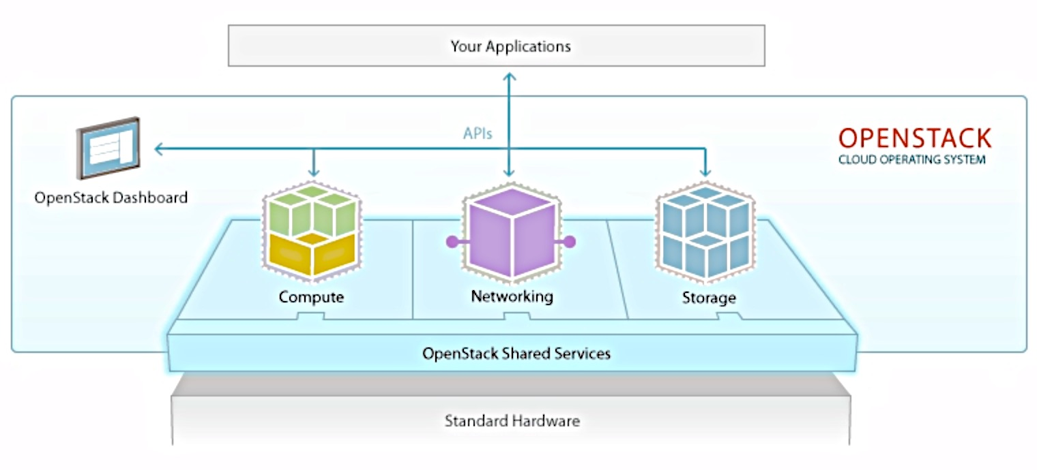
ETSI NFV -> OASIS TOSCA -> Tacker
ETSI
NFV
TOSCA
OpenStack Heat Translator
TOSCA parser
NFV Descriptors
NSD
VNFD
VNFFGD
OpenStack Tacker
(NFVO / VNFM)
Data model
heat-translator

Slide 29
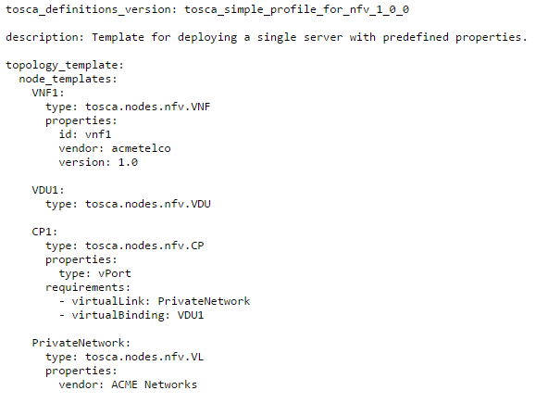
Sample TOSCA NFV Profile
Notes:
https://github.com/openstack/tosca-parser/blob/master/toscaparser/extensions/nfv/tests/data/tosca_helloworld_nfv.yaml

Slide 30
Tacker VNF Forwarding Graph & Service Chaining

Slide 31
Tacker VNF Forwarding Graph Service Function Chaining Integration
Adding Tacker VNF Forwarding Graph APIs
APIs to
Define flow classification rules
Easy to render chains across instantiated VNFs
Precursor to VNF Forwarding Graph Descriptor
ODL-SFC / netvirtsfc driver support
OPNFV Summit Demo using Tacker and ODL
Plan to transition to neutron-sfc driver

Slide 32
Tacker + SFC Overview: (networking-sfc + ODL)
Operator / OSS / BSS
Horizon(GUI)
CLI
API
Templates
Tacker
DB
VNFD
Workflow:
Onboard VNFD to Catalog
Instantiate 2 or more VNFs from Catalog
Invoke Tacker VNFFG API to chain them
NFVO / VNFM / VNFFG API
Heat
ODL Controller
Nova
Neutron
(networking-sfc + ODL)
netconf/
yang
OVSDB
Optional VNF config
using ODL netconf/yang
Compute Node 1
Compute Node 2
VNF
vRouter
VNF
DPI
...
OVS
OVS
Notes:
Separation of concern --- the VNFD and VNF Instance

Slide 33
Tacker Roadmap

Slide 34
Roadmap – Newton and beyond…
Network Services Descriptor (NSD) support
VNF Scaling – Manual + Auto (Senlin)
Splitting off NFV Catalog
VNF Forwarding Graph using Neutron-SFC + ODL
Installed VNFC (SoftwareComponent)
VNF State Notifications
Capture state transitions in local db
Emit state transitions to a mesg bus

Slide 35
Roadmap – Newton and beyond…
cont.
Standalone Tacker
TOSCA CSAR support
HOT Template support (transitional feature)
Pre-position VM images in remote sites (Multi-Site)
Image upgrade

Slide 36
Resources
Tacker vBrownBag
https://www.youtube.com/watch?v=y9fYiIsIErc
Tacker Demo –
https://www.youtube.com/watch?v=EfqWArz25Hg
Tacker Wiki
https://wiki.openstack.org/wiki/Tacker
Tacker Roadmap –
https://etherpad.openstack.org/p/tacker-mitaka-priorities
Tacker Docs
http://tacker-docs.readthedocs.org/en/latest/index.html

Slide 37
Thank you

